Slide 1

Cigarette Consumption
A panel of observations from 1985 - 1995

Slide 2
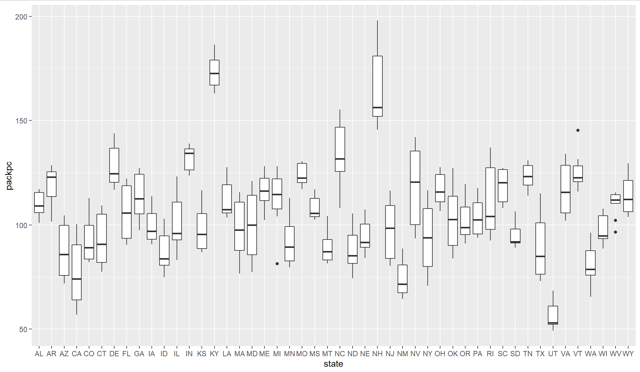
Highest vs. Lowest Average Number of Packs of Cigarettes per Capita per Year

Slide 3
Highest vs. Lowest Average Number of Packs of Cigarettes per Capita per Year
New Hampshire, Kentucky and north Carolina have the highest numbers
Utah, California and new Mexico have the lowest numbers

Slide 4
Cigarette Use In Steady Decline as the Years Advance
Median number of packs per capita from 1985 - 1995

Slide 5
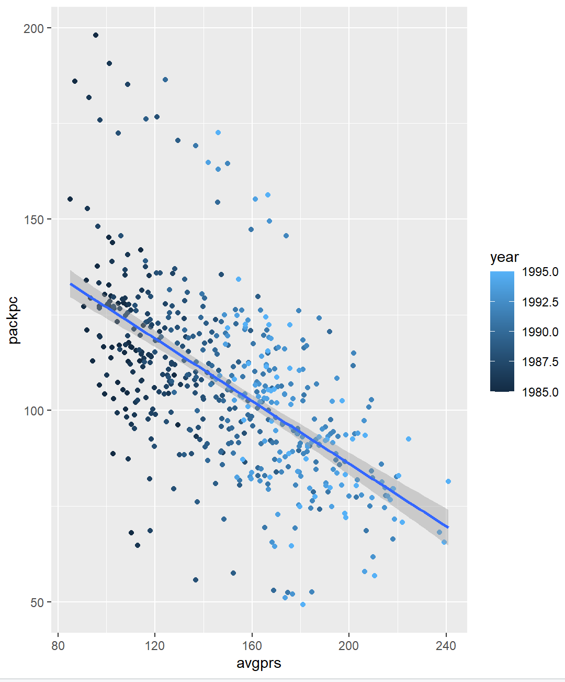
Average Price per Cigarette Pack Rises as Consumption Falls
if cigarette manufacturers are looking to maintain profitability when fewer packs are being sold, they will raise the price to maintain profitability.

Slide 6
Linear Regression for Average Packs per Capita and Average Price, per Year
We expect pack consumption to decrease by .04 for every one unit increase in price

Slide 7
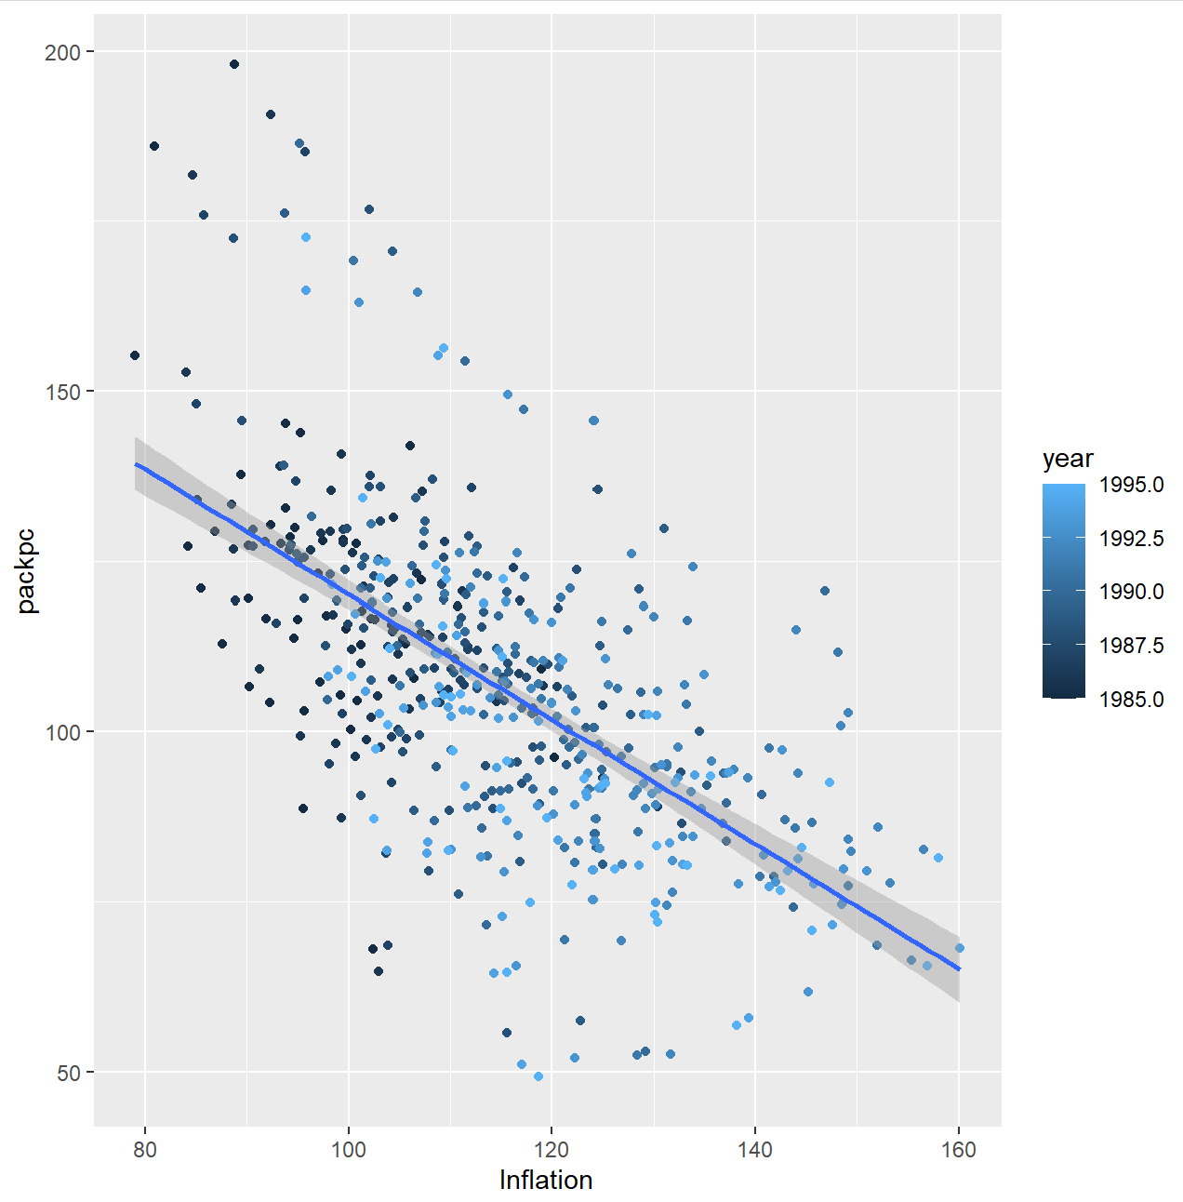
Average Price per Cigarette Pack Adjusted for Inflation
even accounting for inflation, consumption continues to drop

Slide 8
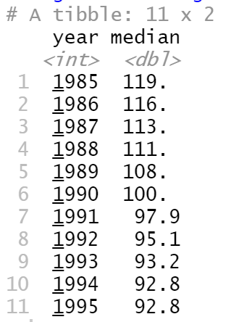
Packs per Capita is Significantly Different from 1995 to 1985
Packs per capita dropped significantly between 1985 and 1995

Slide 9
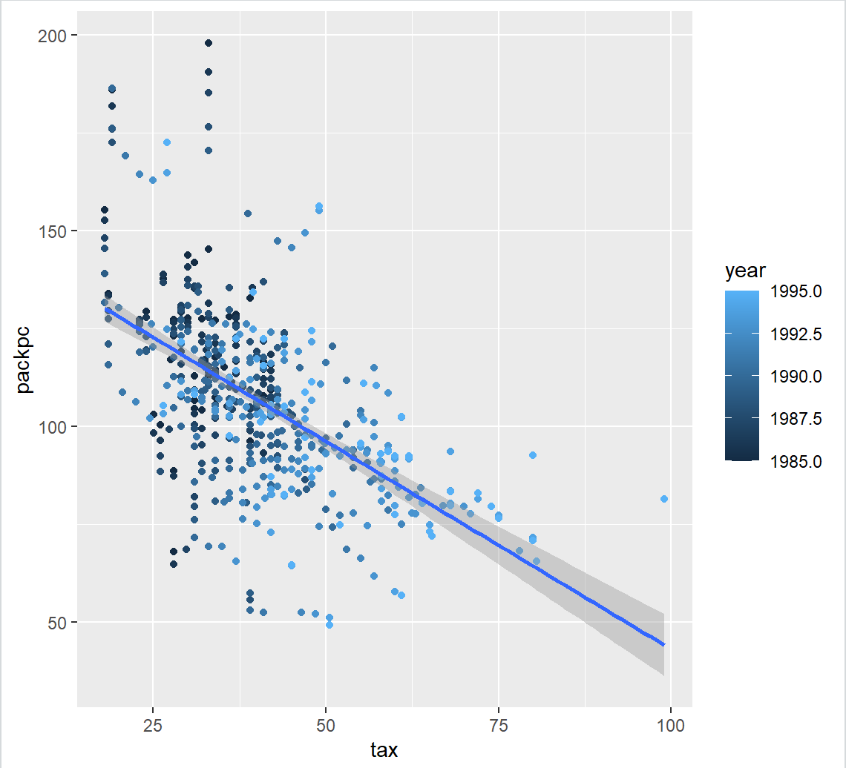
Taxation is Significantly Different from 1995 to 1985
Taxation also increased between 1985 and 1995 as consumption dropped

Slide 10
R Code
library("ggplot") library("dplyr") library(Ecdat) ggplot(Cigarette, aes(x = state, y = packpc)) + geom_boxplot() median_packpc <- Cigarette %>% group_by(year) %>% summarise(Median = median(packpc)) unique(Cigarette$year) ggplot(median_packpc, aes(x = year, y = Median)) + geom_line() ggplot(Cigarette, aes(x = avgprs, y = packpc)) + geom_point() + geom_smooth(method = lm) cor.test(Cigarette$avgprs, Cigarette$packpc, method = "pearson", use = "complete.obs") ggplot(Cigarette, aes(x = avgprs, y = packpc, color = year)) + geom_point() + geom_smooth(method = lm) reg_avgprs_packpc <- lm(packpc~avgprs, Cigarette) summary(reg_avgprs_packpc) price_inflation <- Cigarette %>% mutate(Inflation = avgprs / cpi) View(price_inflation) ggplot(price_inflation, aes(x = Inflation, y = packpc, color = year)) + geom_point() + geom_smooth(method = lm) rows_1985 <- Cigarette %>% filter(year == 1985) rows_1995 <- Cigarette %>% filter(year == 1995) t.test(rows_1995$packpc, rows_1985$packpc, paired = TRUE) t.test(rows_1995$tax, rows_1985$tax, paired = TRUE) ggplot(Cigarette, aes(x = tax, y = packpc, color = year)) + geom_point() + geom_smooth(method = lm) cor.test(Cigarette$tax, Cigarette$packpc, method = "pearson", use = "complete.obs")

